Slide 1
Intro to Data Science
Recitation #3
Tel Aviv University 2017/2018
Slava Novgorodov

Slide 2
Today’s lesson
Introduction to Data Science:
What is learning system?
Simple example
Implementation
Naïve Bayes
Algorithm
Use cases
Implementation

Slide 3
Learning (simple AI) - example
The system starts with only knowing the rules of the game
Initially doing only random moves
Learning the outcome of the game and fixes the strategy
After several iterations the system will be able to do smarter moves
Finally will be able to win every game

Slide 4
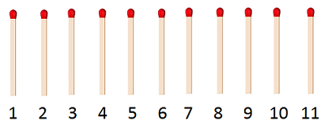
Learning (simple AI) - example
Running example – 11 matchsticks game
Rules: 2 players, taking 1 or 2 matchsticks, turn by turn, until nothing left. The winner is the player that took the last matchstick.

Slide 5
Analysis of the game
Who is the player that wins the game?
Is there an “always win” strategy?
How to solve it?

Slide 6
Analysis of the game
Let’s look on the game from the end.
States 1 and 2 are winning states (In both cases player can take the last matchstick)
Hence state 3 is losing state - any move puts the opponent in the winning state…
Continue – 4 is winning state case it puts the opponent in the losing state… and so on….

Slide 7
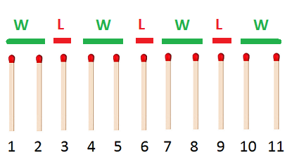
Analysis of the game
As we can see – Player 1 always wins (if plays correctly), because he starts in the winning state
Let’s try to see how we can play against computer.

Slide 8
Teaching computer to play
Let’s give a computer option to decide how many matchsticks it takes for every state.
We will initialize 10 “boxes” (decision units) that will be in charge for the states 2 to 11 (State 1 is trivial).
We initialize each box with two notes: black (with “one” written on it) and white (with “two”)

Slide 9
Teaching computer to play
“The brain”:

Slide 10
Teaching computer to play - strategy
1. The computer checks how many matchsticks left and goes to the box that represents
the corresponding state
2. Then randomly choose from the “notes” inside the box and makes a move accordingly
to what is written on a note (“one” – take 1 matchstick, “two” – take 2)
3. For each step remember which note was chosen.
4. If there are no notes inside – defeat.

Slide 11
Teaching computer to play - learning
If the computer wins – we add same note as was chosen to each box
If the computes loses – remove the note from the last box

Slide 12
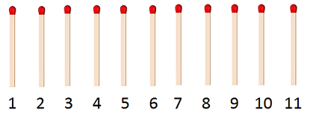
Simulation – Initial
Computer | Player

Slide 13
Simulation – Step 1
Computer | Player
1

Slide 14
Simulation – Step 2
Computer | Player
1 2

Slide 15
Simulation – Step 3
Computer | Player
1 2
2

Slide 16
Simulation – Step 4
Computer | Player
1 2
2 1

Slide 17
Simulation – Step 5
Computer | Player
1 2
2 1
2

Slide 18
Simulation – Step 6
Computer | Player
1 2
2 1
2 1

Slide 19
Simulation – Step 7
Computer | Player
1 2
2 1
2 1
1

Slide 20
Simulation – Step 8
Computer | Player
1 2
2 1
2 1
1 1

Slide 21
Simulation - lose

Slide 22
Simulation – Step 6
Computer | Player
1 2
2 1
2 1

Slide 23
Simulation – Step 7
Computer | Player
1 2
2 1
2 1
2

Slide 24
Simulation - win

Slide 25
After several games…
This is well-trained systems “brain” that never loses

Slide 26
Let’s code!

Slide 27
Naïve Bayes classifier
The classifier based on the Bayes’ theorem:
Widely used in Data Science for:
Sentiment analysis
Documents categorization
Spam detection
Fraud detection

Slide 28
Naïve Bayes classifier - assumptions
Assumptions:
Bag of words – position doesn’t matter
Conditional independence:

Slide 29
Example – Sentiment Analysis
The task: given a review decide if it’s positive or negative
The movie is awesome!
Avoid this place!
Recommended! Will come back again!
The worst place ever!!! ☹
Great place to visit with kids!
Never again! Terrible!
Very bad…
Best food ever! Must visit!

Slide 30
Sentiment Analysis
Use already classified reviews for learning
Represent each review as a vector of words
Calculate probabilities
Review | Class
Never visit again | NEGATIVE
Great place – visit! | POSITIVE
Good food | POSITIVE
Awesome | POSITIVE
Bad place | NEGATIVE
Visit again | POSITIVE
Great food – must visit! | ???

Slide 31
Sentiment Analysis
Use already classified reviews for learning
Represent each review as a vector of words
Calculate probabilities
never | visit | again | great | place | good | food | awesome | bad | must | Class
1 | 1 | 1 |  |  |  |  |  |  |  | NEG
 | 1 |  | 1 | 1 |  |  |  |  |  | POS
 |  |  |  |  | 1 | 1 |  |  |  | POS
 |  |  |  |  |  |  | 1 |  |  | POS
 |  |  |  | 1 |  |  |  | 1 |  | NEG
 | 1 | 1 |  |  |  |  |  |  |  | POS

Slide 32
Sentiment Analysis
P(POS) = 4/6 P(NEG) = 2/6
P(great|POS) = (1+1)/(9+10) = 2/19 P(great|NEG) = (0+1)/(5+10) = 1/15
P(food|POS) = (1+1)/(9+10) = 2/19 P(food|NEG) = (0+1)/(5+10) = 1/15
P(must|POS) = (0+1)/(9+10) = 1/19 P(must|NEG) = (0+1)/(5+10) = 1/15
P(visit|POS) = (2+1)/(9+10) = 3/19 P(visit|POS) = (1+1)/(5+10) = 2/15
P(POS|”great food must visit”) ~ P(POS) *
P(“great”|POS) * P(“food”|POS) * P(“must”|POS) * P(“visit”|POS) =
4/6 * 2/19 * 2/19 * 1/19 * 3/19 = 0.00006138688
P(NEG|”great food must visit”) ~ P(NES) *
P(“great”|NEG) * P(“food”|NEG) * P(“must”|NEG) * P(“visit”|NEG) =
2/6 * 1/15 * 1/15 * 1/15 * 2/15 = 0.00001316872
ArgMax ({P(POS|”…”), P(NEG|”…”)}) = POSITIVE
Review | Class
Never visit again | NEGATIVE
Great place – visit! | POSITIVE
Good food | POSITIVE
Awesome | POSITIVE
Bad place | NEGATIVE
Will visit again | POSITIVE
Great food – must visit! | ???

Slide 33
Let’s code!

Slide 34
Questions?

