Slide 1
Intro to Data Science
Recitation #1
Tel Aviv University 2018/2019
Slava Novgorodov

Slide 2
Administrative
Office Hours: Tuesdays (schedule in advance)
Course website: http://slavanov.com/teaching/ds1819b/
Homeworks: 3 (see schedule on course site)
Mostly programming tasks (Python 2.7)
Submission in pairs (Moodle)
Final grade: 70% exam, 30% exercises

Slide 3
Today’s lesson
Introduction to Data Science:
Hands-on Data Science with Python
Data Understanding
Querying data
Dealing with missing data
Visualization of data

Slide 4
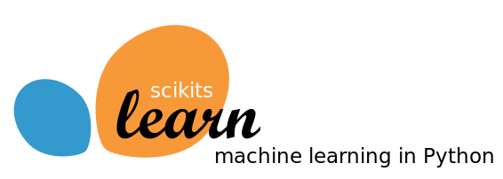
Data Science with
Python version: 2.7
Libraries:
Pandas
NumPy
scikit-learn
matplotlib
…
Both working in jupyter or in IDE are fine!
Anaconda package is recommended!

Slide 5
Recitation structure
Usage of relevant part of the library – demonstration using simple examples
Hands-on solution of real-world problems

Slide 6
Let’s code!

Slide 7
References
http://pandas.pydata.org/
http://www.numpy.org/
http://scikit-learn.org
http://matplotlib.org/
https://anaconda.org/

Slide 8
Questions?

