Slide 1
Intro to Data Science
Summary
Tel Aviv University 2017/2018
Slava Novgorodov

Slide 2
Today’s lesson
Introduction to Data Science:
Recall of course topics
Exam structure
Sample questions

Slide 3
Course Topics
Machine Learning:
Intro to ML
Data understanding and preparation
Feature selection, model evaluation
Supervised/Unsupervised learning
Big Data
Intro to Big Data architectures
MapReduce
Basic SQL and SQL over MapReduce
Hadoop, HDFS
Spark

Slide 4
Where we are
Business
Understanding
Data
Understanding
Data
Preparation
Data
Deployment
Modeling
Evaluation

Slide 5
Handling missing data: removing it
Ignore the feature
Pro: Simple, typically not biased
Con: May be a very useful feature
Ignore the sample
Pro: Simple, all features are kept
Con: Removed samples may be biased
Con: Data may become small
Intel – Advanced Analytics

Slide 6
Data imputation
Estimate the missing values
Simple data imputation: Mean, median, mode
Mean (Reliability): (5+5+2+1+3+3+1+3+3)/9 = 2.88
Median (Reliability): 1 1 2 3 3 3 3 5 5
Mode (Country): USA = 6, Japan = 3, Korea = 1.
Intel – Advanced Analytics

Slide 7
Algorithms we touched in-depth
K-Means
kNN
Naïve – Bayes
Decision Trees
Regressions
SVM

Slide 8
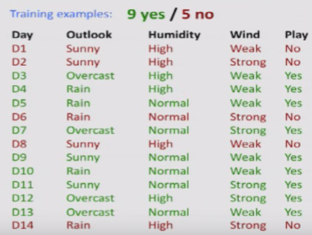
Decision Trees

Slide 9
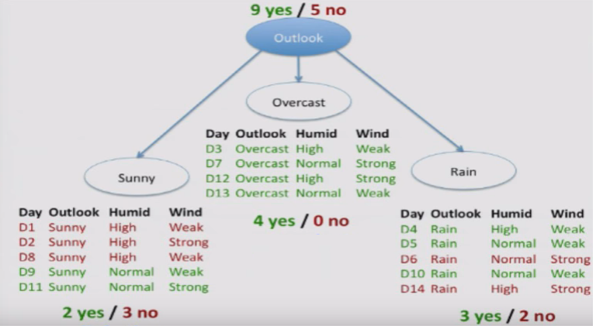
Decision Trees

Slide 10
Decision Trees

Slide 11
Bayesian view in a (very small) nutshell
We see evidenceX, such as the CPU tests results
We have Prior probabilities for having a bad CPU, e.g.:
P(C=good) = 0.99; P(C=bad) = 1-0.99 = 0.01
We obtain the Likelihood: Probability of evidence, given each class, e.g.: P( X | C= good) = 0.17
We compute Posterior probabilities: Probability of class, afterseeing the evidence, e.g. P(C=good | X )
Bayes rule:
, where $p\left(x\right)=\sum_{c}{P\left(C\right) p\left(x | C\right)}$
posterior
prior
likelihood
evidence

Slide 12
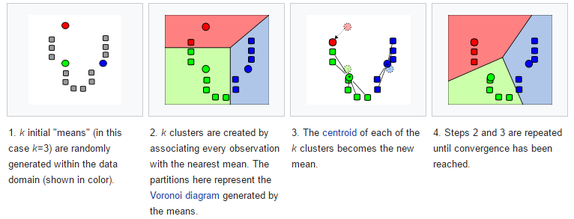
K-Means – Recall from Recitation 2
Used for clustering of unlabeled data
Example: Image compression

Slide 13
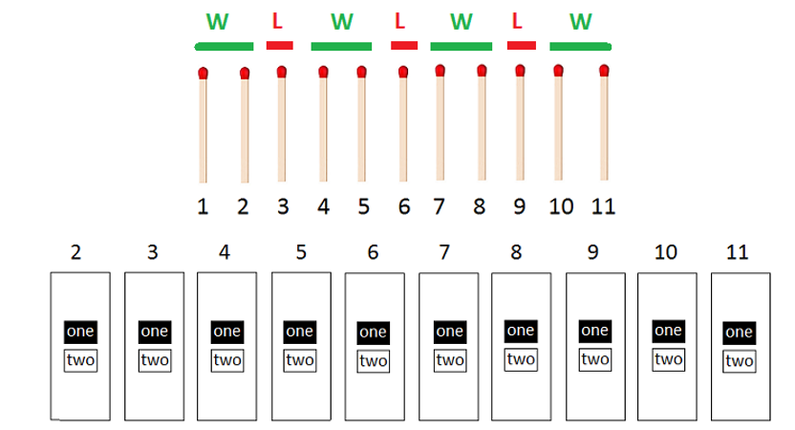
Learning systems
Recall the 11 matchsticks problem we discussed in class on Recitation #3

Slide 14
Big Data
Map Reduce principles, Hadoop, HDF
SQL over Map Reduce
General questions solved with Map Reduce
Spark and differences from Hadoop

Slide 15
Exam Structure
Two equal-points parts: ML and BigData
ML: 8-10 closed/short open questions
BigData: 4-5 open questions
Sample questions: in class…

Slide 16
Questions?

