Slide 1
Intro to Data Science
Recitation #2
Tel Aviv University 2017/2018
Slava Novgorodov

Slide 2
Today’s lesson
Introduction to Data Science:
Hands-on Data Science with Python
K-Means
scikit-learn library
Linear Regression
Mean Square Error
Cross Validation

Slide 3
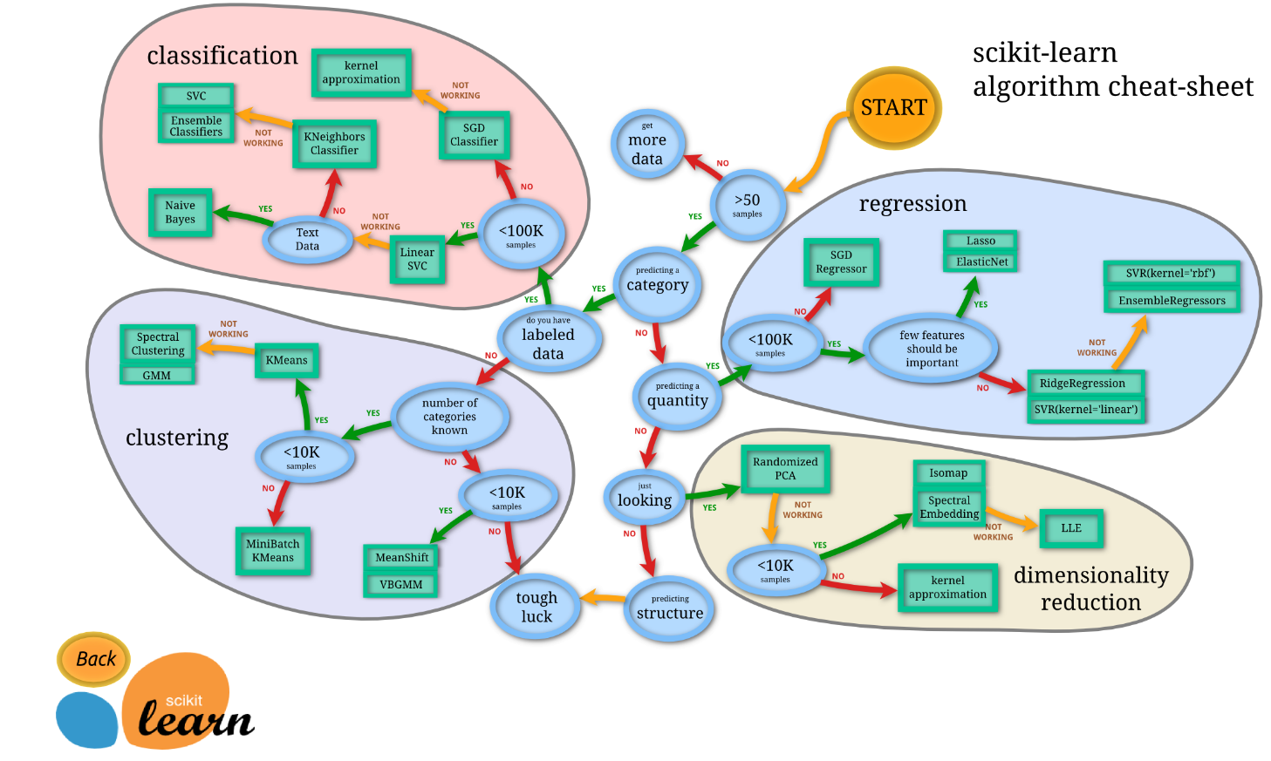
Choosing the right algorithm

Slide 4
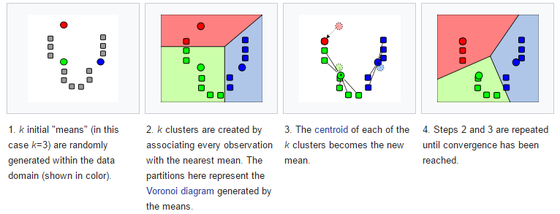
K-Means
Used for clustering of unlabeled data
Example: Image compression

Slide 5
Let’s code!

Slide 6
References
http://pandas.pydata.org/
http://www.numpy.org/
http://scikit-learn.org
http://matplotlib.org/
https://anaconda.org/

Slide 7
Questions?

