Slide 1
Intro to Data Science
Recitation #4
Tel Aviv University 2016/2017
Slava Novgorodov

Slide 2
Today’s lesson
Introduction to Data Science:
Map Reduce Paradigm
Recall
Examples
Connection to previous parts of the course
MapReduce vs. Spark
Discussion
Examples

Slide 3
MapReduce Paradigm
MapReduce is a programming model and an associated implementation for processing and generating big data sets with a parallel, distributed algorithm on a cluster
Map() – performs filtering and sorting
Reduce() – performs a summary operation

Slide 4
When to use MapReduce?
Problems that are huge, but not hard
Problems that easy to parallelize (easily partitionable and combinable)
You should only implement Map and Reduce!

Slide 5
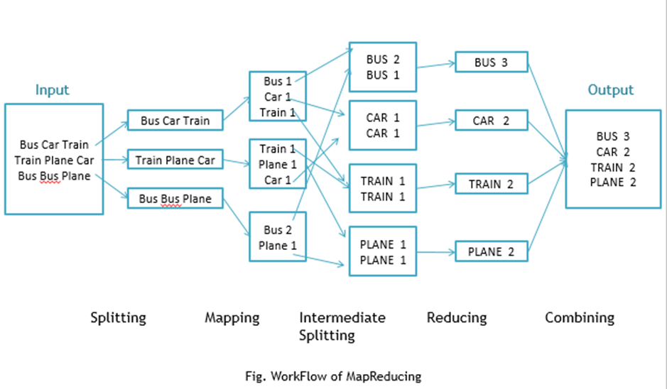
WordCount – the “Hello, World!” of MapReduce

Slide 6
WordCount – implementation
Map:
def mapfn(k, v):
for w in v.split():
yield w, 1
Reduce:
def reducefn(k, vs):
result = sum(vs)
return result
This particular implementation is in Python (as the rest of the recitation).
Java, Scala and other languages are also supported.
It’s not important to remember the syntax, remember the pseudo-code

Slide 7
Running our first MapReduce
The default option – Hadoop (installed on TAU servers)
Installing Hadoop distribution from a Docker
Lightweight mode – Python “simulator” e.g. https://github.com/ziyuang/mincemeatpy

Slide 8
Running on Hadoop
hadoop \
jar <path_to_hadoop.jar> \
-mapper "python mapper.py" \
-reducer "python reducer.py" \
-input "wordcount/mobydick.txt" \
-output "wordcount/output"
For the simplicity, we will use the python “simulator” of MapReduce.

Slide 9
Social Networks example
Task: Find all mutual friends of all pairs of users
Input:
A -> B C D
B -> A C D E
C -> A B D E
D -> A B C E
E -> B C D
Output:
('A', 'D') -> {'B', 'C’}
('A', 'C') -> {'D', 'B’}
('A', 'B') -> {'D', 'C’}
('B', 'C') -> {'D', 'A', 'E’}
('B', 'E') -> {'D', 'C’}
('B', 'D') -> {'A', 'C', 'E’}
('C', 'D') -> {'A', 'B', 'E’}
('C', 'E') -> {'D', 'B’}
('D', 'E') -> {'B', 'C'}

Slide 10
Social Networks example - solution
Solution: friends.py
Map:
def mapfn(k, v):
d = v.split("->")
friends = set(d[1].strip().split(" "))
for w in friends:
first = d[0].strip()
second = w
if first > second:
temp = first
first = second
second = temp
yield (first, second), friends
Reduce:
def reducefn(k, vs):
ret = vs[0]
for s in vs:
ret = ret.intersection(s)
return ret

Slide 11
Social Networks example - data
Data: https://snap.stanford.edu/data/egonets-Facebook.html
The format is not the same as in previous example.
How we will convert it to the same format?

Slide 12
Crawling and incoming links
Task: Find all incoming links for web-pages
Input:
A.com -> B.com C.com
B.com -> D.com E.com
C.com -> A.com E.com
D.com -> A.com E.com
E.com -> D.com
Output:
A.com -> ['C.com', 'D.com']
B.com -> ['A.com’]
C.com -> ['A.com’]
E.com -> ['B.com', 'C.com', 'D.com’]
D.com -> ['B.com', 'E.com']

Slide 13
Incoming links example - solution
Solution: incoming_links.py
Map:
def mapfn(k, v):
d = v.split("->")
pages = set(d[1].strip().split(" "))
for w in pages:
yield w, d[0].strip()
Reduce:
def reducefn(k, vs):
return vs

Slide 14
Important tokens in search queries
Task: Find all “important” tokens in search queries
Input:
cheap smartphone
new movies
smartphone
…
interesting movies
Output:
cheap REGULAR
smartphone IMPORTANT
new REGULAR
movies IMPORTANT
…

Slide 15
Important tokens example - solution
Solution: important_tokens.py
Map:
def mapfn(k, v):
d = v.split("->")
pages = set(d[1].strip().split(" "))
for w in pages:
yield w, d[0].strip()
Reduce:
def reducefn(k, vs):
return vs

Slide 16
Most popular term in search queries
With MapReduce – easy…
What if we have only one machine with super-limited memory - like we can store only 5 words and 5 counters. And we want to find 5 most popular search terms.
Ideas?

Slide 17
Most popular term in search queries
Solution: Misra-Gries algorithm for approximate counts on streams
Model the queries terms as a stream and maintain the counters.
If a counter for a specific term exists – increment
If there is no counter for a term, but still enough memory – add new counter
If there is no memory, decrement every counter by 1, remove 0 counters

Slide 18
Misra-Gries – step-by-step
K = 2
Stream = “cheap, blue, smartphone, Barcelona, cheap, cheap, Barcelona, smartphone, cheap, Barcelona, cheap, Barcelona, smartphone, blue, cheap, Barcelona , …”
Processing now: cheap
Memory: {(cheap, 1)}

Slide 19
Misra-Gries – step-by-step
K = 2
Stream = “cheap, blue, smartphone, Barcelona, cheap, cheap, Barcelona, smartphone, cheap, Barcelona, cheap, Barcelona, smartphone, blue, cheap, Barcelona , …”
Processing now: blue
Memory: {(cheap, 1), (blue,1)}

Slide 20
Misra-Gries – step-by-step
K = 2
Stream = “cheap, blue, smartphone, Barcelona, cheap, cheap, Barcelona, smartphone, cheap, Barcelona, cheap, Barcelona, smartphone, blue, cheap, Barcelona , …”
Processing now: smartphone
Memory: {(cheap, 0), (blue,0)}

Slide 21
Misra-Gries – step-by-step
K = 2
Stream = “cheap, blue, smartphone, Barcelona, cheap, cheap, Barcelona, smartphone, cheap, Barcelona, cheap, Barcelona, smartphone, blue, cheap, Barcelona , …”
Processing now: Barcelona
Memory: {(Barcelona,1)}

Slide 22
Misra-Gries – step-by-step
K = 2
Stream = “cheap, blue, smartphone, Barcelona, cheap, cheap, Barcelona, smartphone, cheap, Barcelona, cheap, Barcelona, smartphone, blue, cheap, Barcelona , …”
Processing now: cheap
Memory: {(Barcelona,1), (cheap,1)}

Slide 23
Misra-Gries – step-by-step
K = 2
Stream = “cheap, blue, smartphone, Barcelona, cheap, cheap, Barcelona, smartphone, cheap, Barcelona, cheap, Barcelona, smartphone, blue, cheap, Barcelona , …”
Processing now: cheap
Memory: {(Barcelona,1), (cheap,2)}

Slide 24
Misra-Gries – step-by-step
K = 2
Stream = “cheap, blue, smartphone, Barcelona, cheap, cheap, Barcelona, smartphone, cheap, Barcelona, cheap, Barcelona, smartphone, blue, cheap, Barcelona , …”
Processing now: Barcelona
Memory: {(Barcelona,2), (cheap,2)}

Slide 25
Misra-Gries – step-by-step
K = 2
Stream = “cheap, blue, smartphone, Barcelona, cheap, cheap, Barcelona, smartphone, cheap, Barcelona, cheap, Barcelona, smartphone, blue, cheap, Barcelona , …”
Processing now: smartphone
Memory: {(Barcelona,1), (cheap,1)}

Slide 26
Misra-Gries – step-by-step
K = 2
Stream = “cheap, blue, smartphone, Barcelona, cheap, cheap, Barcelona, smartphone, cheap, Barcelona, cheap, Barcelona, smartphone, blue, cheap, Barcelona , …”
Processing now: cheap
Memory: {(Barcelona,1), (cheap,2)}

Slide 27
Misra-Gries – step-by-step
K = 2
Stream = “cheap, blue, smartphone, Barcelona, cheap, cheap, Barcelona, smartphone, cheap, Barcelona, cheap, Barcelona, smartphone, blue, cheap, Barcelona , …”
Processing now: Barcelona
Memory: {(Barcelona,2), (cheap,2)}

Slide 28
Misra-Gries – step-by-step
K = 2
Stream = “cheap, blue, smartphone, Barcelona, cheap, cheap, Barcelona, smartphone, cheap, Barcelona, cheap, Barcelona, smartphone, blue, cheap, Barcelona , …”
Processing now: cheap
Memory: {(Barcelona,2), (cheap,3)}

Slide 29
Misra-Gries – step-by-step
K = 2
Stream = “cheap, blue, smartphone, Barcelona, cheap, cheap, Barcelona, smartphone, cheap, Barcelona, cheap, Barcelona, smartphone, blue, cheap, Barcelona , …”
Processing now: Barcelona
Memory: {(Barcelona,3), (cheap,3)}

Slide 30
Misra-Gries – step-by-step
K = 2
Stream = “cheap, blue, smartphone, Barcelona, cheap, cheap, Barcelona, smartphone, cheap, Barcelona, cheap, Barcelona, smartphone, blue, cheap, Barcelona , …”
Processing now: smartphone
Memory: {(Barcelona,2), (cheap,2)}

Slide 31
Misra-Gries – step-by-step
K = 2
Stream = “cheap, blue, smartphone, Barcelona, cheap, cheap, Barcelona, smartphone, cheap, Barcelona, cheap, Barcelona, smartphone, blue, cheap, Barcelona , …”
Processing now: blue
Memory: {(Barcelona,1), (cheap,1)}

Slide 32
Misra-Gries – step-by-step
K = 2
Stream = “cheap, blue, smartphone, Barcelona, cheap, cheap, Barcelona, smartphone, cheap, Barcelona, cheap, Barcelona, smartphone, blue, cheap, Barcelona , …”
Processing now: cheap
Memory: {(Barcelona,1), (cheap,2)}

Slide 33
Misra-Gries – step-by-step
K = 2
Stream = “cheap, blue, smartphone, Barcelona, cheap, cheap, Barcelona, smartphone, cheap, Barcelona, cheap, Barcelona, smartphone, blue, cheap, Barcelona , …”
Processing now: Barcelona
Memory: {(Barcelona,2), (cheap,2)}

Slide 34
Misra-Gries – step-by-step
K = 2
Stream = “cheap, blue, smartphone, Barcelona, cheap, cheap, Barcelona, smartphone, cheap, Barcelona, cheap, Barcelona, smartphone, blue, cheap, Barcelona , …”
Output: {(Barcelona,2), (cheap,2)}
Real counts: {(cheap,6), (Barcelona,2), (smartphone,3), (blue,2)}
The Top-K is the same!
In worst case may be wrong, depends on a stream.
For theoretical results: http://www.cs.utexas.edu/users/misra/scannedPdf.dir/FindRepeatedElements.pdf

Slide 35
Pseudo-synonyms
Data – queries:
buy cheap house
buy big house
buy new house
rent cheap car
rent new car
rent Volkswagen car
…
Desired output:
cheap – new (2)
Ideas? How many M/R stages needed?
Python implementation – HW

Slide 36
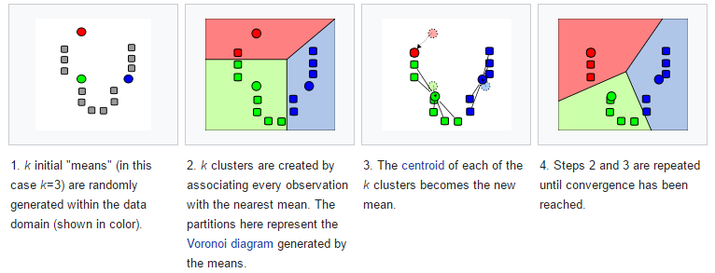
K-Means – Recall from Recitation 2
Used for clustering of unlabeled data
Example: Image compression

Slide 37
K-Means – animation
Very good animation here:
http://shabal.in/visuals/kmeans/2.html

Slide 38
K-Means – animation

Slide 39
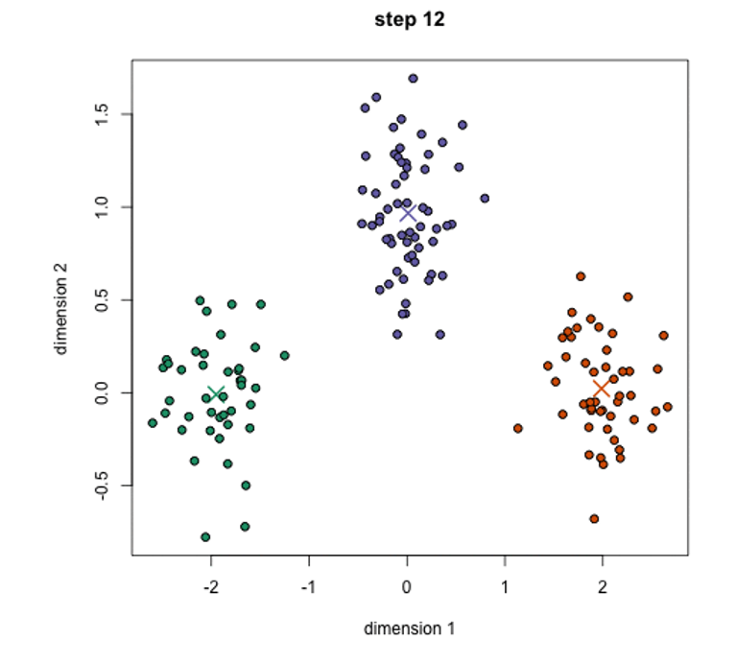
K-Means – step #12

Slide 40
K-Means on MapReduce
Data – points (x,y) in [0,1]x[0,1]:
0.72 0.44
0.16 0.82
0.42 0.37
0.19 0.65
…
Desired output:
(0.72 0.44) (0.55 0.83)
(0.16 0.82) (0.55 0.83)
(0.42 0.37) (0.29 0.16)
…
Python implementation – HW

Slide 41
K-Means – solution sketch
Map:
See if there is centroids in a file, if no, generate randomly k points.
On map stage, check for each point the closest
c1 (0.72 0.44)
c2 (0.16 0.82)
c3 (0.42 0.37)
c2 (0.19 0.65)
…
Reduce:
Calculate new centroids, see if there are point that want to change…
Important note: the algorithm is iterative and should run until stopping condition reached (Which stopping condition?)
Python implementation – HW

Slide 42
MapReduce disadvantages
Iterative tasks that needs to be executed again and again (such as many ML algorithms), will store intermediate results on the hard drive, i.e. we will pay I/O for storing “useless” data
Map Reduce executes JVM on each iteration – hence we have some constant running cost
To solve such tasks, we can use Spark, which generalizes the MapReduce idea, and saves on unnecessary I/O

Slide 43
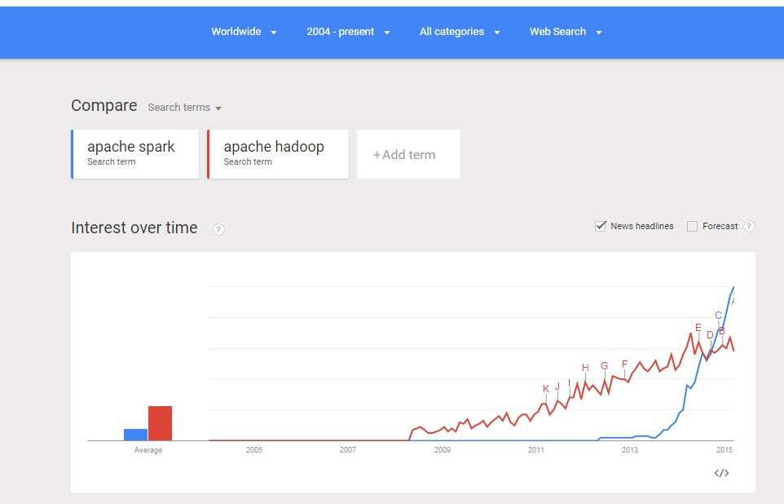
Spark vs. Hadoop

Slide 44
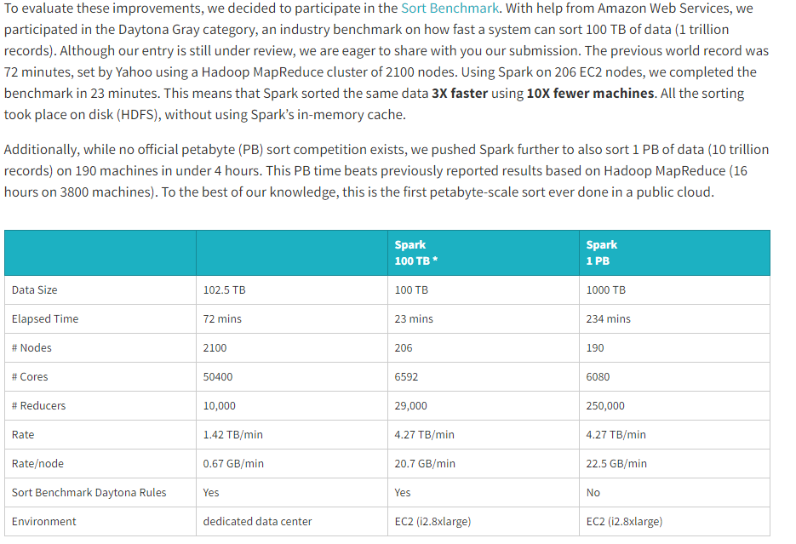
Spark vs. Hadoop

Slide 45
K-Means in Spark
spark = SparkSession.builder.appName("PythonKMeans").getOrCreate()
lines = spark.read.text(sys.argv[1]).rdd.map(lambda r: r[0])
data = lines.map(parseVector).cache()
K = int(sys.argv[2])
convergeDist = float(sys.argv[3])
kPoints = data.takeSample(False, K, 1)
tempDist = 1.0
while tempDist > convergeDist:
closest = data.map(lambda p: (closestPoint(p, kPoints), (p, 1)))
pointStats = closest.reduceByKey(lambda p1_c1, p2_c2: (p1_c1[0] + p2_c2[0], p1_c1[1] + p2_c2[1]))
newPoints = pointStats.map(lambda st: (st[0], st[1][0] / st[1][1])).collect()
tempDist = sum(np.sum((kPoints[iK] - p) ** 2) for (iK, p) in newPoints)
for (iK, p) in newPoints:
kPoints[iK] = p
print("Final centers: " + str(kPoints))
spark.stop()

Slide 46
When still should we use Hadoop?
How fast you need your results? Examples:
You process updated data once a day and data should be ready next day for reviews or analysis.
Application that sends recommended products to subscribers
When you have longer time say a week or 2 weeks to process data.
If you can afford longer data processing latency, it will be much “cheaper”. If you buy an expensive server that process data in 30 minutes and the rest 23 hours 30 minutes is idle, you can buy a cheaper server and process data in say 8 hours (e.g. overnight)

Slide 47
References
http://stevekrenzel.com/finding-friends-with-mapreduce
https://www.slideshare.net/andreaiacono/mapreduce-34478449
https://spark.apache.org/docs/latest/programming-guide.html
https://habrahabr.ru/post/103490/ (Russian)

Slide 48
Questions?

