Slide 1
Data-Centered Crowdsourcing Workshop
Prof. Tova Milo
Slava Novgorodov
Tel Aviv University 2016/2017

Slide 2
Projects
The team size is around 4 students and should be decided by the next week
The projects should be done during the semester
There is one “touch-base” meeting in a month and submission at the last week of the semester (demo day)
The topic and the technology is up to you (we teach web programming using PHP, JavaScript and HTML and provide an SDK)
The project should be interesting and solve real problem in the world of crowdsouring

Slide 3
Projects
In general there are two possible options for the projects:
Application (Web or Mobile) – an app that solves concrete problem using crowdsourcing (for example: Application for text translation)
Infrastructure – provides an option for application to integrate with it, and solves more general crowdsourcing problem (for example: Platform for matching users to questions/tasks)
In both cases, students should prepare an end-to-end demonstration of their projects

Slide 4
Crowdsourcing application
Possible options for applications projects:
Tagging images (or in general: Adding metadata to multimedia content) using crowd
Text translation, adaptation, shortening, improvement (TL;DR)
Answering questions/queries using crowd
Planning and scheduling with the crowd
Geo-spartial applications based on crowd (use crowd locations to improve your data)
Building knowledge base (incl. cleaning)
…

Slide 5
Crowdsourcing INFRASTRUCTURE
Possible options for infrastructure projects:
Crowdsourcing platform design and implementation (AMTurk, CrowdFlower, …)
Matching crowd users to questions/tasks (based on their preferences/test questions/performance)
Payment and incentives model for crowd (solving the problem of trade-off between budget and quality)
Budget management and payment strategies
Ordering/Sequences of questions to crowd (session model and context)
Spamming detection
Load balancing

Slide 6
Collecting meta-data from multimedia
Existing projects:
The ESP game – tagging images
Tag a Tune – audio annotation
Squigl – detect objects on images
Verbosity – a common knowledge trainer (game)
More projects – Games with a Purpose
More ideas for projects:
Video tagging, events detection using crowd

Slide 7
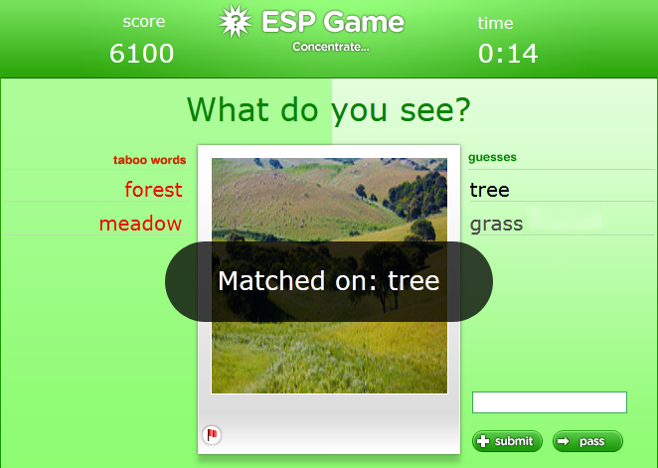
The esp game

Slide 8
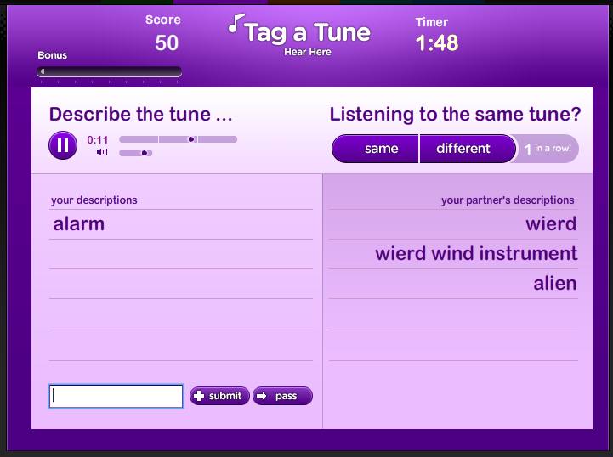
Tag a tune

Slide 9
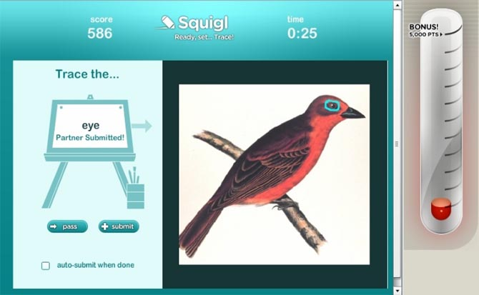
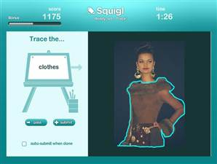
SQUIGL

Slide 10
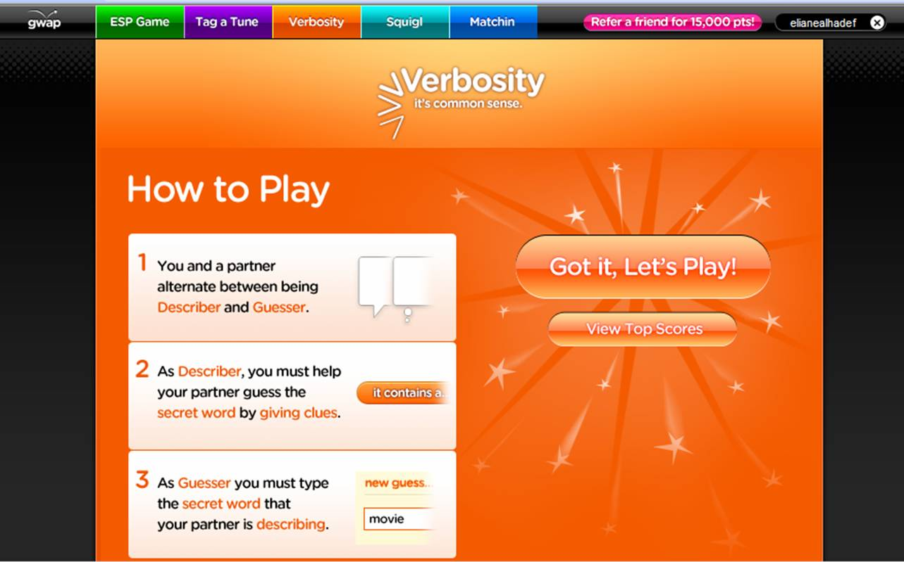
verbosity

Slide 11
Text translation
Existing projects:
Paper from UPenn by Zaidan & Callison-Burch
Facebook localization was partially done by crowd
GetLocalization.com
TL;DR community
Google translate “improve translation” feature
More ideas for projects:
Projects like English Wikipedia → Simple English Wiki

Slide 12
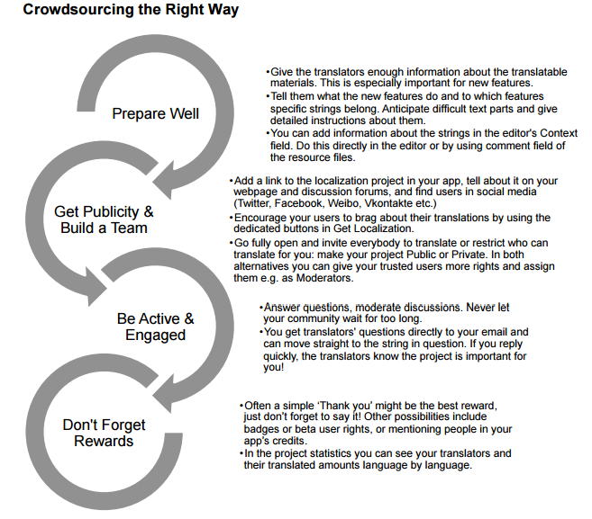
Get localization

Slide 13
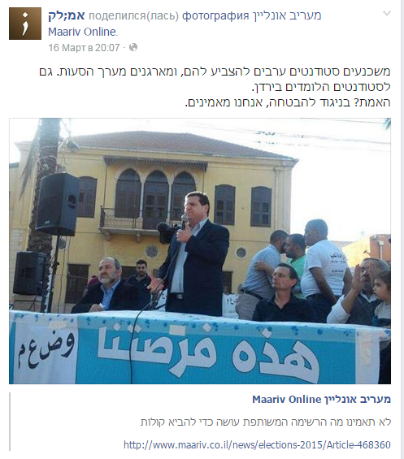
TL;DR Facebook community

Slide 14
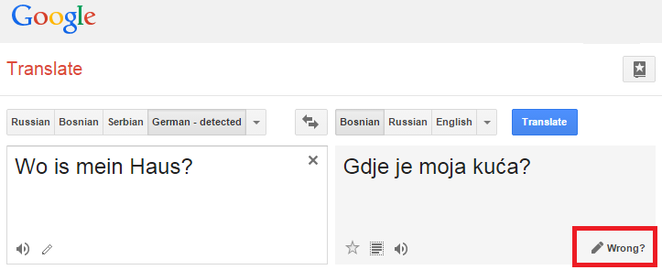
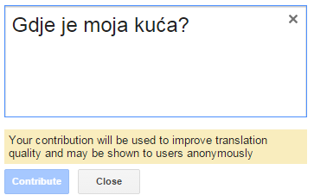
Google translate

Slide 15
Answering questions and queries with crowd
Existing projects:
StackOverflow
TripAdvisor
Yahoo! Answers
A lot of “academical” research to make such projects more structured and focused (OASSIS, AskIt, …)
More ideas for projects:
Free text to queries translation (using crowd)
Meta-queries

Slide 16
Planning with crowd
Existing projects:
CrowdPlannr (academical research, TAU)
CrowdCierge (also academical, MIT)
More ideas for projects:
Events planning
Schedule
Suggestions
Work split and sharing
Better (more general) CrowdPlannr…

Slide 17
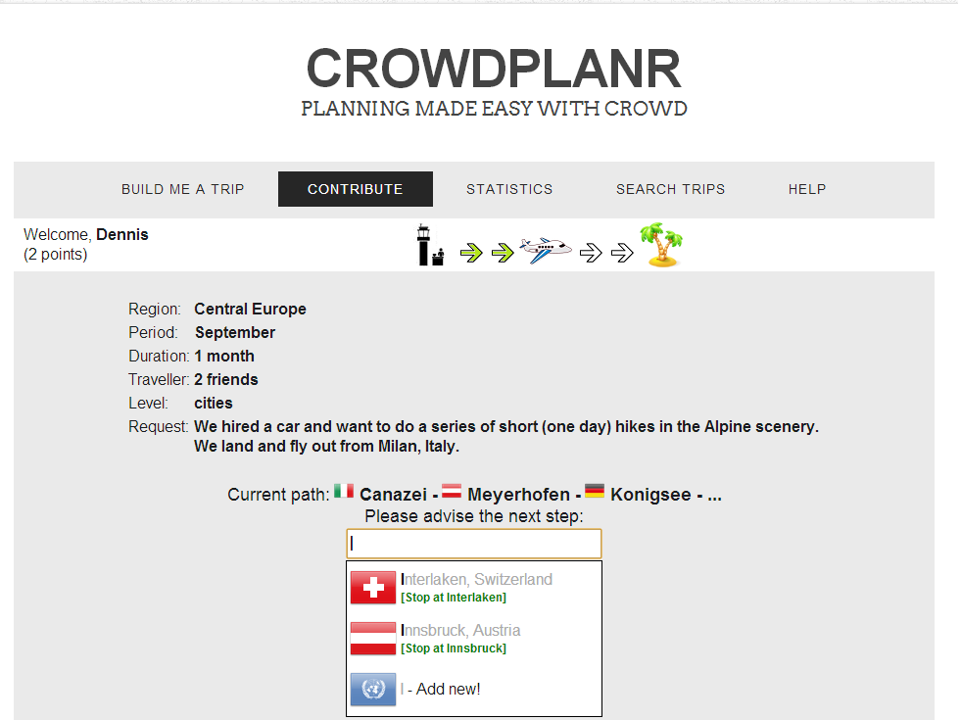

Slide 18
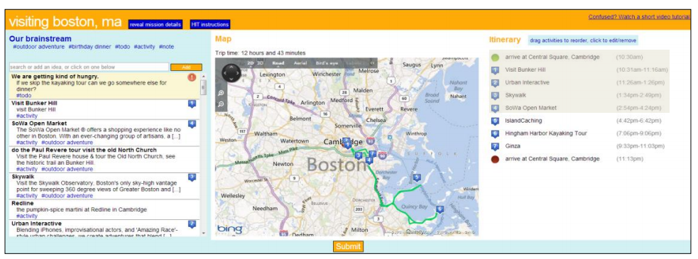
crowdcierge

Slide 19
GEOSPATRIAL CROWD APPS
Existing projects:
Scores & Video city maps – soccer fans visualization
Waze
OpenStreetMaps – collaborative mapping
More ideas for projects:
Wikipedia missing photos
If there is a missing photo of some place, you can ask user to upload it (if he is currently there)
Geo-based tasks and job sequence planning
Crowd-based layers over existing maps

Slide 20
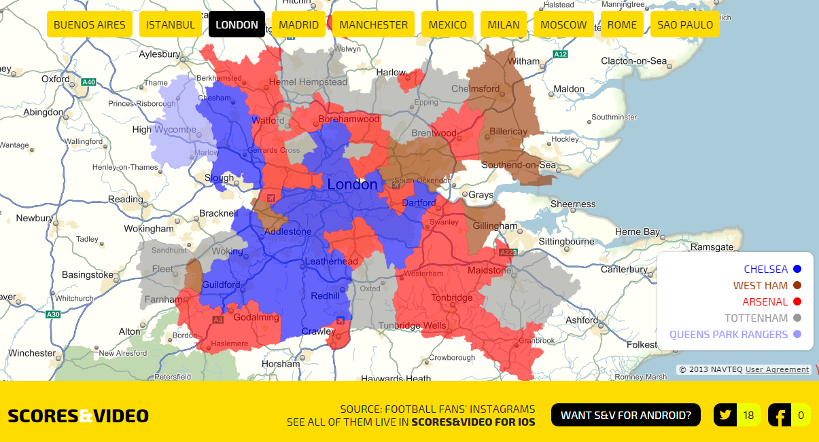
Scores&video city maps

Slide 21
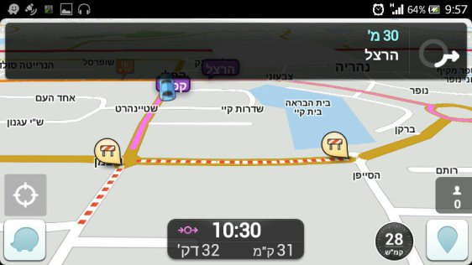
Waze

Slide 22
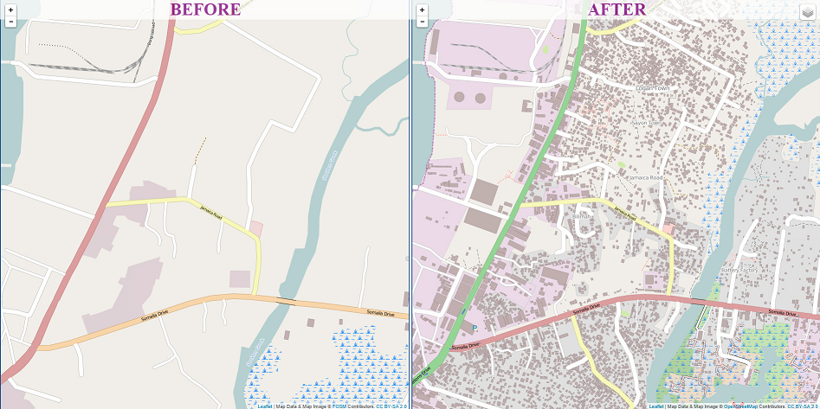
Openstreetmaps

Slide 23
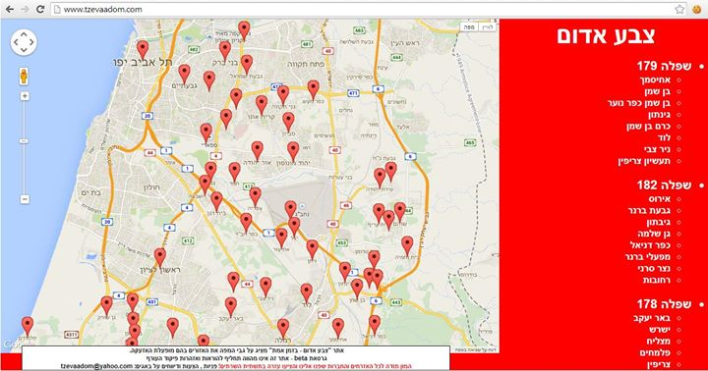
Tzevaadom.com

Slide 24
Building knowledgebase
Existing projects:
YAGO (academical, not crowdsourcing)
OASSIS (academical, crowd minning)
QOCO (academical, query-oriented)
More ideas for projects:
Building database of popular facts (common knowledge)
Building database of “rare”/not documented facts
Enrich datasets with semantics
Combine multipledatasets

Slide 25
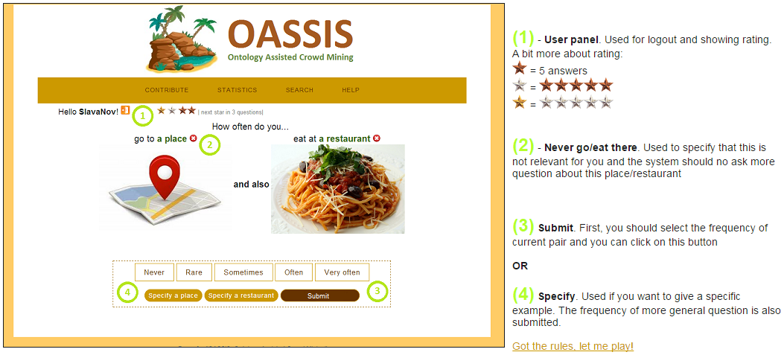
OASSIS

Slide 26
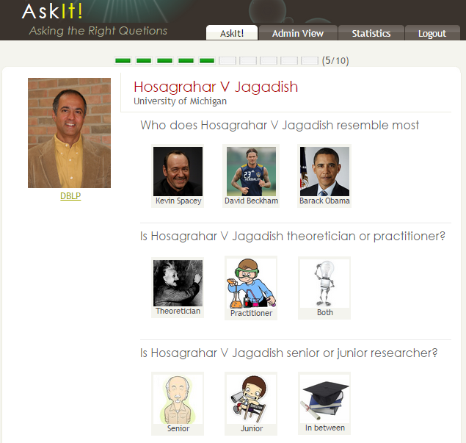
ASKIT

Slide 27
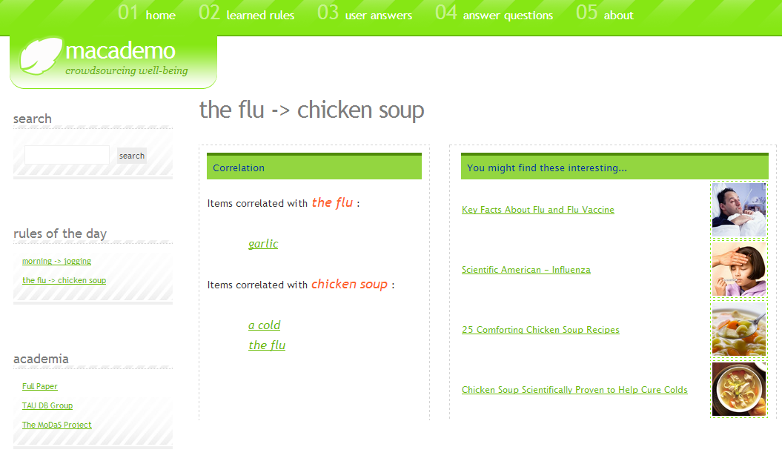
TEASERS

Slide 28
GUESS & Trivia

Slide 29
Crowdsourcing INFRASTRUCTURE
Possible options for infrastructure projects:
Crowdsourcing platform design and implementation (AMTurk, CrowdFlower, …)
Matching crowd users to questions/tasks (based on their preferences/test questions/performance)
Payment and incentives model for crowd (solving the problem of trade-off between budget and quality)
Budget management and payment strategies
Ordering/Sequences of questions to crowd (session model and context)
Spamming detection
Load balancing

Slide 30
Crowdsourcing PLATFORM
Existing projects:
Amazon Mechanical Turk (microtasks)
CrowdFlower
oDesk (for big projects)
More ideas for projects:
Better management panel
Better connection to users

Slide 31
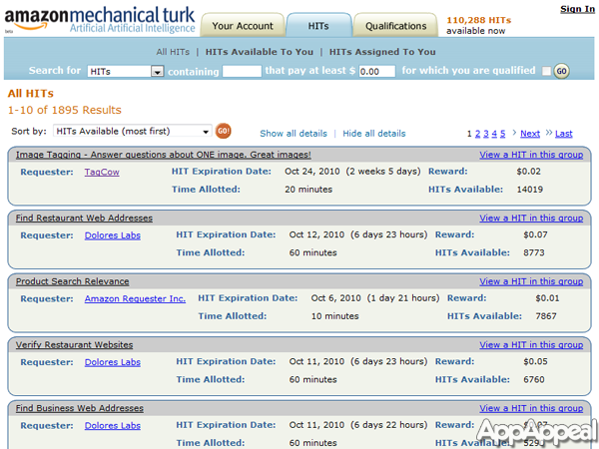
Mechanical turk

Slide 32
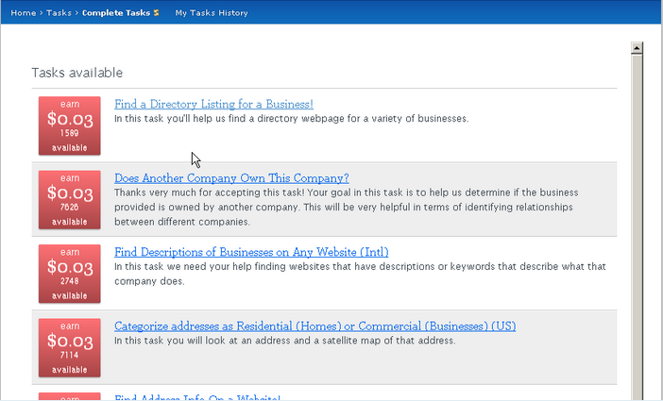
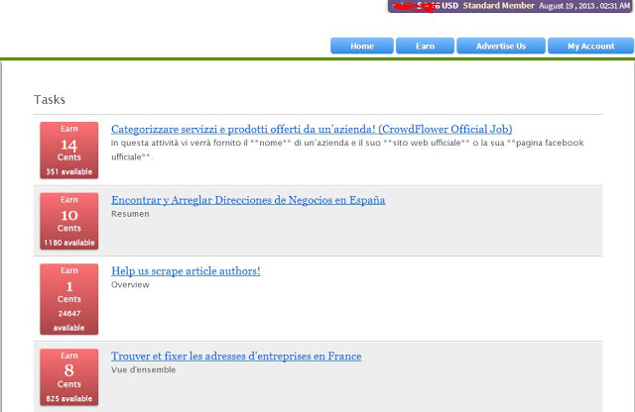
crowdflower

Slide 33
Matching crowd users to questions/tasks
The matching can be done based on:
User preference
Requester preference (“Give me 5 people from US, that are experts in baseball”)
Qualification tests
More?

Slide 34
Payment and incentives
Create the real “free” market:
Bidding
Monopoles and workers unions
Long-term contracts
Quality / Payment tradeoff
…

Slide 35
Budget management
Easier way to manage your workers
Algorithmic budget allocation
Manual preferences
Better UI (control panel)
…

Slide 36
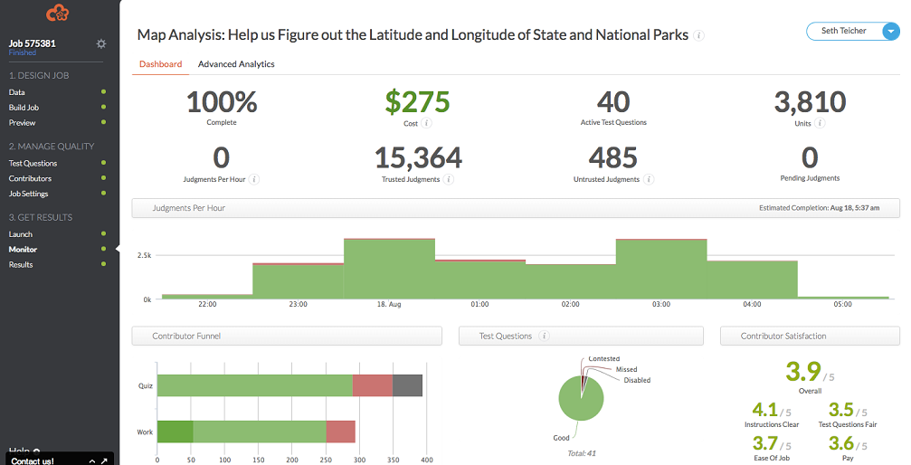
Management panel

Slide 37
Ordering of tasks
Crowd users have different preferences
Many tasks of the same type
Many tasks in the same context
Different tasks
“Easy-Only” (less money per tasks – more tasks)
“Difficult-Only”
Mixed
…

Slide 38
Spamming detection
Detect spammers
Don’t hurt real crowd (can cost you reputation)
Provide high quality and low latency
…

Slide 39
Load balancing
The tasks should be done by all the crowd…
There are many “strong” crowd users, and many requesters willing to get them
Not always available
…

Slide 40
Questions?

