Slide 1
Data-Centered Crowdsourcing Workshop
Prof. Tova Milo
Slava Novgorodov
Tel Aviv University 2015/2016

Slide 2
Administrative notes
Course goal:
Learn about crowd-data sourcing and prepare a final project (improvement of existing problem’s solution / solving new problem)
Group size: ~4 students
Requirements: DataBases (SQL) is recommended, Web programming (we will do a short overview), (optionally) Mobile development (we will not teach it)

Slide 3
Administrative notes (2)
Schedule:
3 intro meetings
1st meeting – overview of crowdsourcing
2nd meeting – open problems, possible projects
3rd meeting – Web programming overview, SDK
Mid-term meeting
Final meeting and projects presentation
Dates: http://slavanov.com/teaching/crowd1516a/

Slide 4
What is Crowdsourcing?
Crowdsourcing = Crowd + Outsourcing
Crowdsourcing is the act of sourcing tasks traditionally performed by specific individuals to a group of people or community (crowd) through an open call.

Slide 5
CrowdSourcing
Main idea: Harness the crowd to a “task”
Task: solve bugs
Task: find an appropriate treatment to an illness
Task: construct a database of facts
…
Why now?
Internet and smart phones …
We are all connected, all of the time!!!

Slide 6
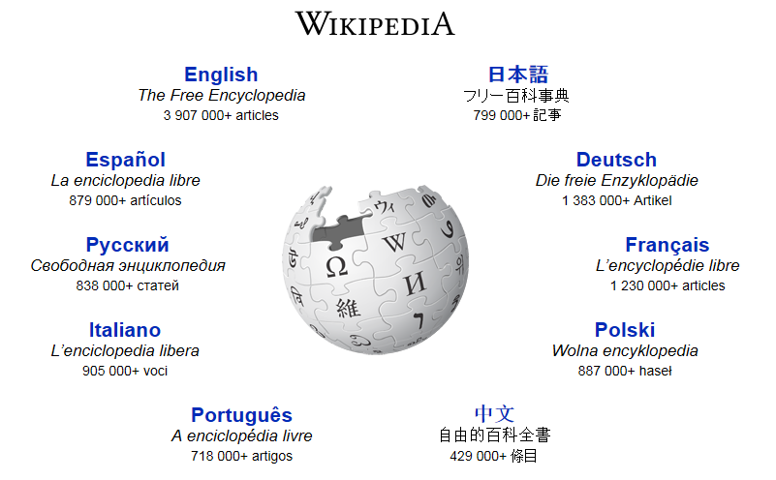
The classical example

Slide 7
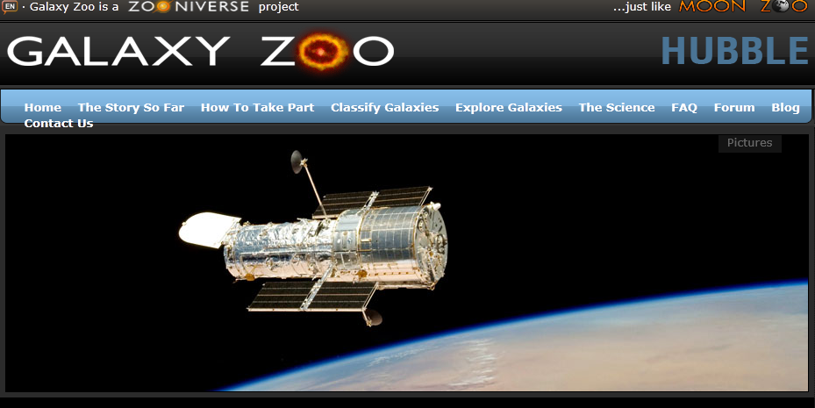
Galaxy Zoo

Slide 8
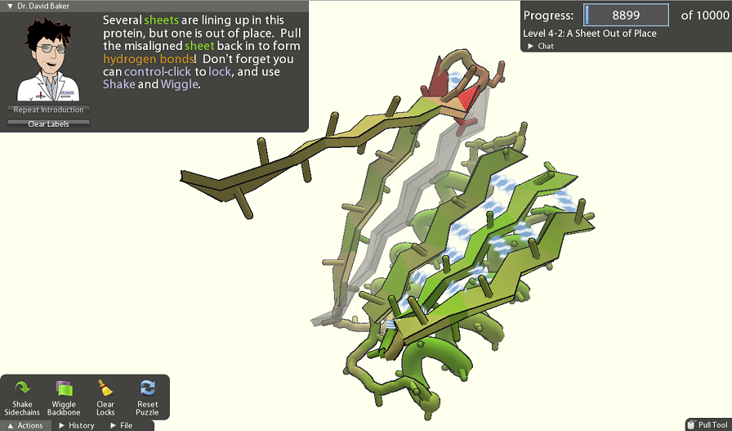
More

Slide 9
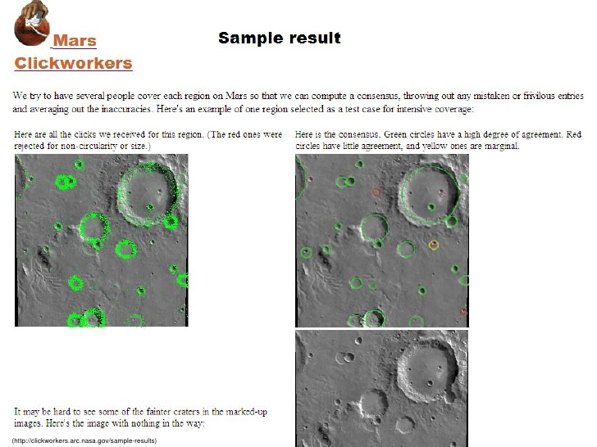
And even More

Slide 10
CrowdSourcing: Unifying Principles
Main goal
“Outsourcing” a task to a crowd of users
Kinds of tasks
Tasks that can be performed by a computer, but inefficiently
Tasks that can’t be performed by a computer
Challenges
How to motivate the crowd?
Get data, minimize errors, estimate quality
Direct users to contribute where is most needed \ they are experts

Slide 11
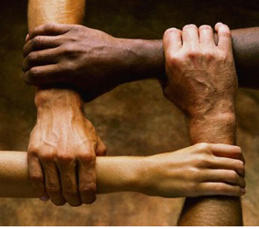
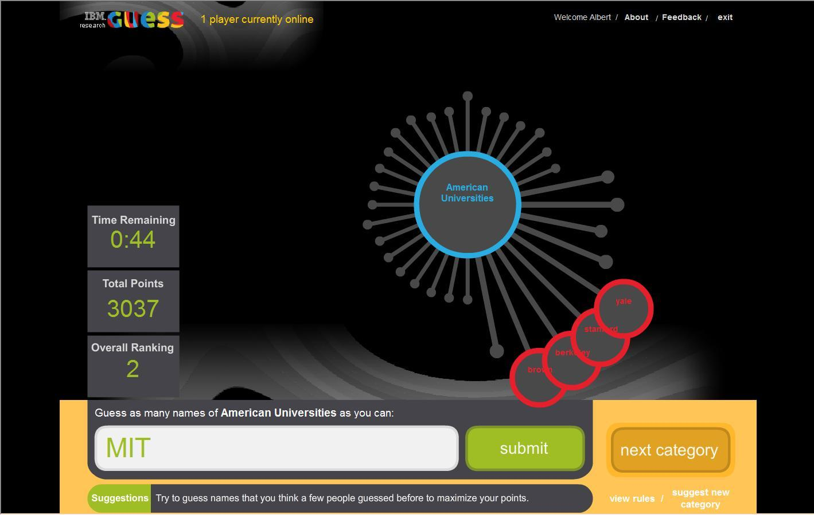
Motivating the Crowd
Altruism
Fun
Money

Slide 12
Crowd Data Sourcing
Outsourcing data collection to the crowd of Web users
When people can provide the data
When people are the only source of data
When people can efficiently clean and/or
organize the data
Two main aspects [DFKK’12]:
Using the crowd to create better databases
Using database technologies to create better crowd datasourcing applications
[DFKK’12]: Crowdsourcing Applications and Platforms: A Data Management Perspective, A.Doan, M. J. Franklin, D. Kossmann, T. Kraska, VLDB 2011

Slide 13
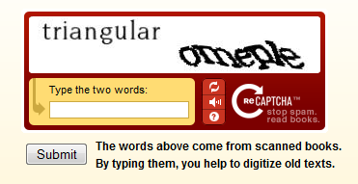
My favorite example
ReCaptha
100,000 web sites
40 million words/day

Slide 14
Crowdsourcing research groups
An incomplete list of groups working on Crowdsourcing:
Qurk (MIT)
CrowdDB (Berkeley and ETH Zurich)
Deco (Stanford and UCSC)
CrowdForge (CMU)
HKUST DB Group
WalmartLabs
MoDaS (Tel Aviv University)
…

Slide 15
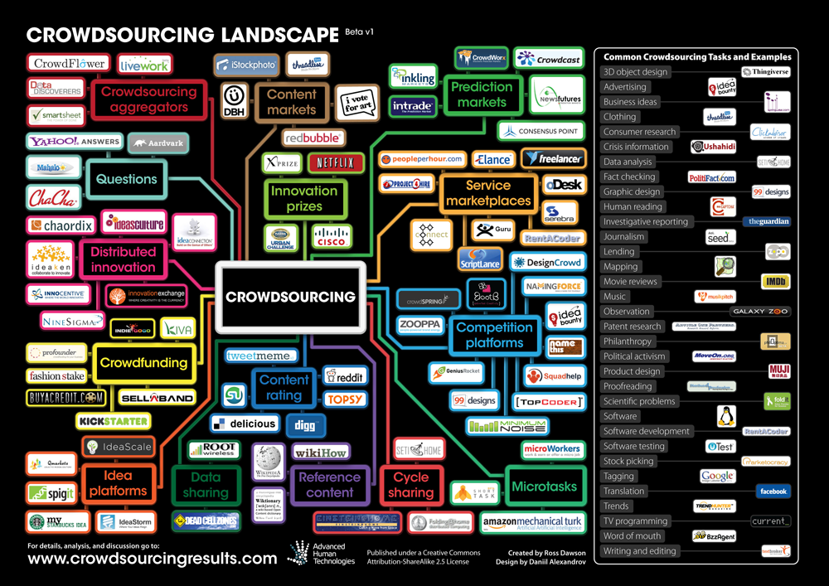

Slide 16
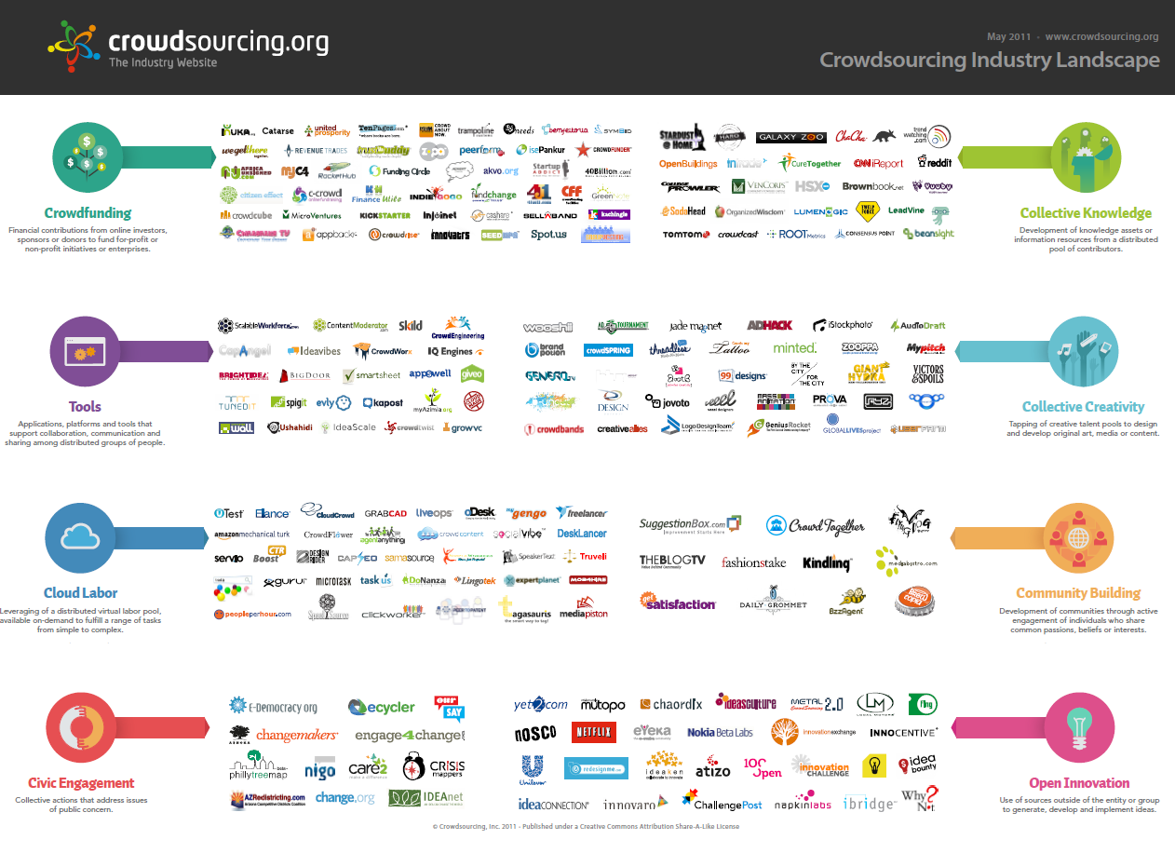

Slide 17
Crowdsourcing Marketplaces

Slide 18
Mechanical Turk

Slide 19
Mechanical Turk
Requestor places Human Intelligence Tasks (HIT)
Min price: $0,01
Provide expiration date and UI
# of assignments
Requestor approve jobs and payments
Special API
Workers choose jobs, do them and getting money

Slide 20
Uses of Human Computation
Data cleaning/integration (ProPublica)
Finding missing people (Haiti, Fossett, Gray)
Translation/Transcription (SpeakerText)
Word Processing (Soylent)
Outsourced insurance claims processing
Data journalism (Guardian)

Slide 21
Types of Tasks
Source: “Paid Crowdsourcing”, SmartSheet.com

Slide 22
Overview of recent research
Crowdsourced Databases, Query evaluation, Sorts/joins, Top-K
CrowdDB, Qurk, Deco,
Crowdsourced Data Collection/Cleaning
AskIt, QOCO,….
Crowd sourced Data Mining
CrowdMining, OASSIS, …
Image tagging, media meta-data collection
Crowdsourced recommendations and planning

Slide 23
Crowd sourced Databases
Motivation:
Why we need crowdsourced databases?
There are many things (queries) that cannot be done (answered) in classical DB approach
We call them: DB-Hard queries
Examples…

Slide 24
DB-Hard Queries (1)
SELECT Market_Cap FROM Companies WHERE Company_Name = ‘I.B.M’
Result: 0 rows
Problem: Entity Resolution

Slide 25
DB-Hard Queries (2)
SELECT Market_Cap FROM Companies WHERE Company_Name = ‘Apple’
Result: 0 rows
Problem: Closed World Assumption

Slide 26
DB-Hard Queries (3)
SELECT Image FROM Images
WHERE Theme = ‘Business Success’ ORDER BY relevance
Result: 0 rows
Problem: Missing Intelligence

Slide 27
CrowdDB
Use the crowd to answer DB-Hard queries
Use the crowd when:
Looking for new data (Open World Assumption)
Doing a fuzzy comparison
Recognize patterns
Don’t use the crowd when:
Doing anything the computer already does well

Slide 28
Closed World vs Open World
OWA
Used in Knowledge representation
CWA
Used in classical DBMS
Example:
Statement: Marry is citizen of France
Question: Is Paul citizen of France?
CWA: No
OWA: Unknown

Slide 29
CrowdSQL – Crowd column
DDL Extension:
CREATE TABLE Department (
university STRING ,
name STRING ,
url CROWD STRING ,
phone STRING ,
PRIMARY KEY ( university , name )
);

Slide 30
CrowdSQL – Example #1
INSERT INTO Department (university, name) VALUES (“TAU”, “CS”);
Result:
University | Name | Url | Phone
TAU | CS | CNULL | NULL

Slide 31
CrowdSQL – Example #2
SELECT url FROM Department WHERE name = “Math”;
Side effect of this query:
Crowdsourcing of CNULL values of Math departments

Slide 32
CrowdSQL – Crowd table
DDL Extension:
CREATE CROWD TABLE Professor(
name STRING PRIMARY KEY ,
email STRING UNIQUE ,
university STRING ,
department STRING ,
FOREIGN KEY ( university , department )
REF Department ( university , name )
);

Slide 33
CrowdSQL – Subjective comparisons
Two functions
CROWDEQUAL
Takes 2 parameters and asks the crowd to decide if they are equals
~= is a syntactic sugar
CROWDORDER
Used when we need the help of crowd to rank or order results

Slide 34
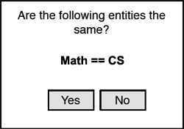
CROWDEQUAL Example
SELECT profile FROM department WHERE name ~= “CS”;
To ask for all "CS" departments, the following query could be posed. Here, the query writer asks the crowd to do entity resolution with the possibly different names given for Computer Science in the database.

Slide 35
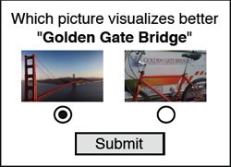
CROWDORDER Example
SELECT p FROM Picture WHERE subject = “Golden Gate Bridge”
ORDER BY CROWDORDER (p, “Which picture visualizes better %subject”);
The following CrowdSQL query asks for a ranking of pictures with regard to how well these pictures depict the Golden Gate Bridge.

Slide 36
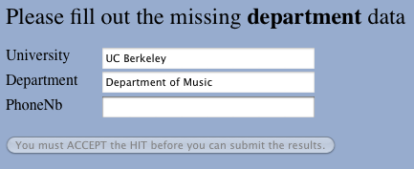
UI Generation
Clear UI is key to quality of answers and response time
SQL Schema to auto-generated UI

Slide 37
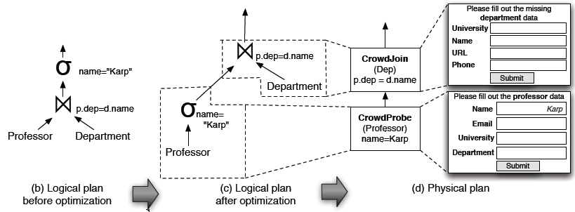
Query plan generation
Query: SELECT * FROM d Professor p, Department d
WHERE d.name = p.dep AND p.name = “Karp”

Slide 38
Dealing with Open-World

Slide 39
Qurk (MIT): Declarative workflow management system that allows human computation over data
(human is a part of query execution)

Slide 40
QURK: The beginning
Schema
celeb(name text, img url)
Query
SELECT c.name FROM celeb AS c WHERE isFemale(c)
UDF(User Defined Function) - isFemale:
TASK isFemale(field) TYPE Filter:
Prompt: "<table><tr> \
<td><img src=’%s’></td> \
<td>Is the person in the image a woman?</td> \
</tr></table>", tuple[field]
YesText: "Yes"
NoText: "No"
Combiner: MajorityVote

Slide 41
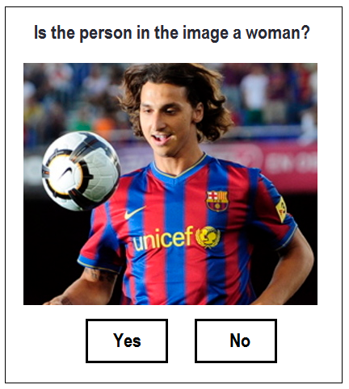
isFemale function (UI)

Slide 42
JOIN
Schema
photos(img url)
Query
SELECT c.name FROM celeb c JOIN photos p
ON samePerson(c.img, p.img)
samePerson:
TASK samePerson(f1, f2) TYPE EquiJoin:
SingluarName: "celebrity"
PluralName: "celebrities"
LeftPreview: "<img src=’%s’ class=smImg>",tuple1[f1]
LeftNormal: "<img src=’%s’ class=lgImg>",tuple1[f1]
RightPreview: "<img src=’%s’ class=smImg>",tuple2[f2]
RightNormal: "<img src=’%s’ class=lgImg>",tuple2[f2]
Combiner: MajorityVote

Slide 43
Join – UI example
# of HITs = |R| * |S|

Slide 44
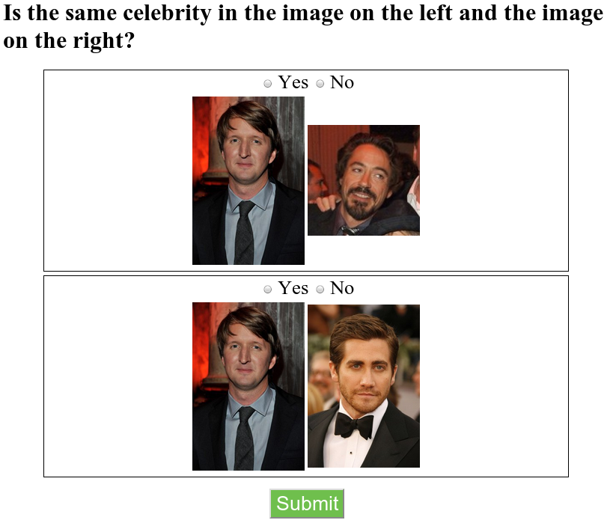
Join – Naïve Batching
# of HITs = (|R| * |S|) / b

Slide 45
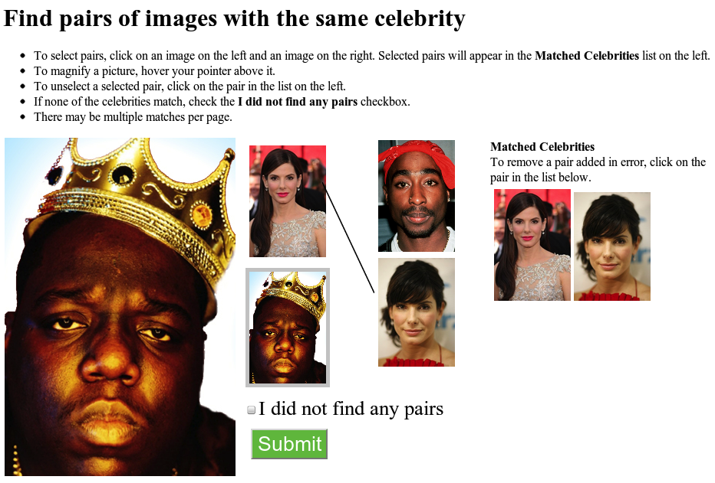
Join – Smart Batching
# of HITs = (|R| * |S|) / (r * s)

Slide 46
Feature extraction
SELECT c.name FROM celeb c JOIN photos p
ON samePerson(c.img,p.img)
AND POSSIBLY gender(c.img) = gender(p.img)
AND POSSIBLY hairColor(c.img) = hairColor(p.img)
AND POSSIBLY skinColor(c.img) = skinColor(p.img)
TASK gender(field) TYPE Generative:
Prompt: "<table><tr> \
<td><img src=’%s’> \
<td>What this person’s gender? \
</table>", tuple[field]
Response: Radio("Gender",
["Male","Female",UNKNOWN])
Combiner: MajorityVote

Slide 47
Economics of feature extraction
Dataset: Table1 [20 rows] x Table2 [20 rows]
Join with no filtering (Cross Product): 400 comparisons
Filtering on 1 parameter (say gender):
+40 extra HITS
For example: 11 females, 9 males in Table1
10 females, 10 males in Table2
Join after filtering: ~100 comparisons
No-Filter/Filter HITs ratio: 400/140
Decrease the number of HITs ~ 3x

Slide 48
POSSIBLY filters selection
Gender?

Slide 49
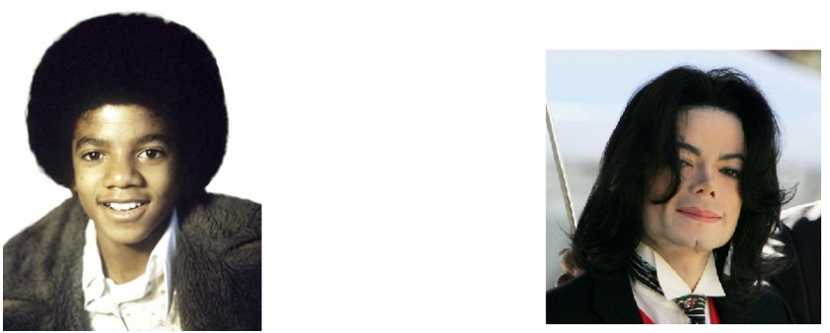
POSSIBLY filters selection
Skin color?

Slide 50
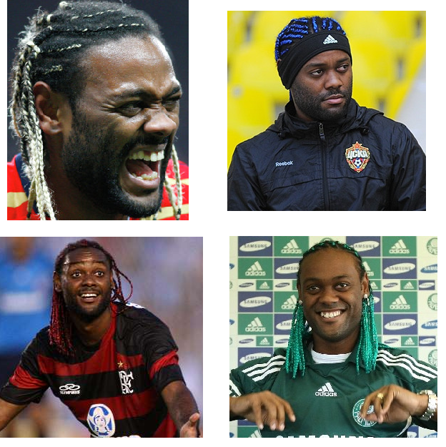
POSSIBLY filters selection
Hair color???

Slide 51
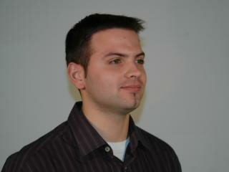
QURK – more features: counting with crowd
Given a dataset of images, run queries on it (filtering, aggregation).
Images are unlabeled
No prior knowledge on distribution.
crowd-powered selectivity estimation
50%
1%

Slide 52
Motivating example #1
Schema
people (name varchar2(32), photo img)
Query
SELECT * FROM people
WHERE gender=“Male” AND hairColor=“red”

Slide 53
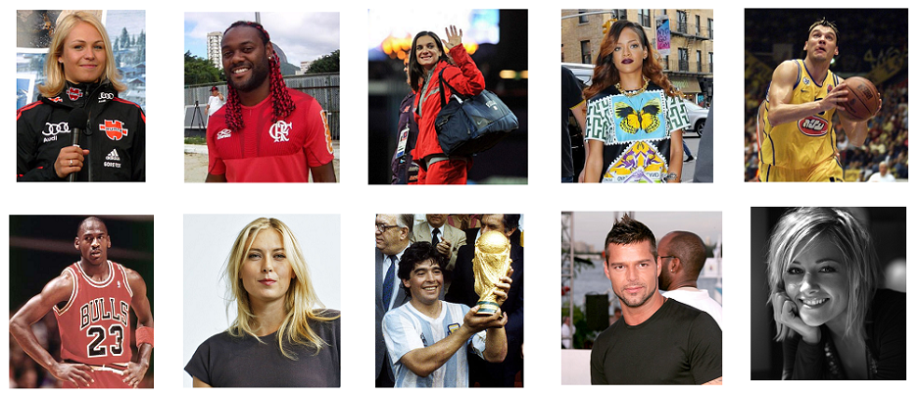
Motivating example #1

Slide 54
Motivating example #1
Filter by gender(photo) = ‘male’

Slide 55
Motivating example #1
Filter by hairColor(photo) = ‘red’

Slide 56
Motivating example #1
Filter by gender(photo) = ‘male’ , the by hairColor(photo) = ‘red’
First pass: 10 HITs (result – 5 photos)
Second pass: 5 HIT
Total: 15 HITs
Filter by hairColor(photo) = ‘red’, then by gender(photo) = ‘male’
First pass: 10 HITs (result – 1 photo)
Second pass: 1 HIT
Total: 11 HITs

Slide 57
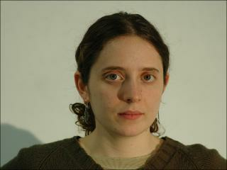
how many males/females?

Slide 58
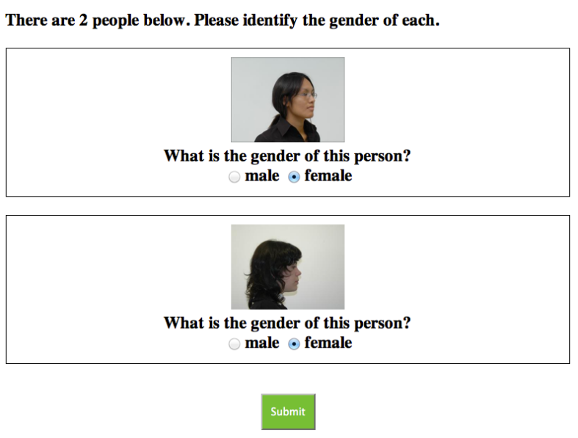
interface: labeling

Slide 59
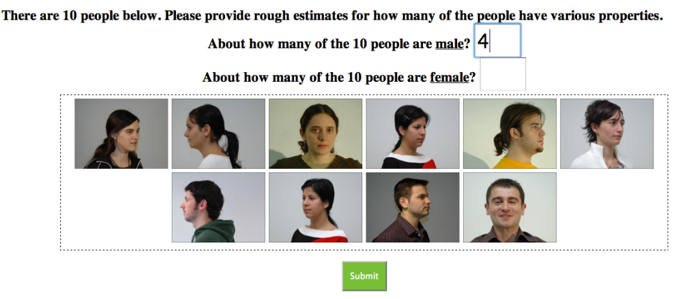
interface: counting

Slide 60
Estimating counts
Can’t show all the images to every user
Show random sample
Sampling error
Worker error
Dependent samples

Slide 61
Counting vs labeling
Dataset: 500 images
Labeling
10 images per HIT (can be 5 – 20)
5 workers per HIT (majority) (can be 3 – 7)
Total HITs = 500/10 * 5 = 250
Counting
75 images per HIT (can be 50 – 150)
1 worker per HIT (spammer detection algo – later)
Total HITs = 500/75 = 7
x37.5 times cheaper!

Slide 62
Avoiding spammers: formal
If no spammers, just average all the results
Average the contribution of each user = Fi (really helps!)
Initialize:
Define:
Iterate:
Finally:

Slide 63
Avoiding spammers: Demonstration
actual
fraction
new
average
average
confidence
interval
outlier
0
fraction of males
1

Slide 64
Coordinated attacks
actual
fraction
0
fraction of males
1

Slide 65
Coordinated attacks
actual
fraction
0
fraction of males
1

Slide 66
solution: add random known results

Slide 67
Gold standard images
Not only 1 “golden truth” task
Each worker complete only 1-2 tasks
Spammers can identify those tasks
But distribute “golden truth” over all tasks
Old approx.: F = C/R
New approx.: F = (C-G)/(R-G)
C – count provided by worker
R – number of items
G – number of golden truth images

Slide 68
random results weaken Coordinated attackers
actual
fraction
0
fraction of males
1

Slide 69
tradeoff
can withstand extreme coordinated attacks (>70% attackers)
in exchange for commensurate
number of known labels

Slide 70
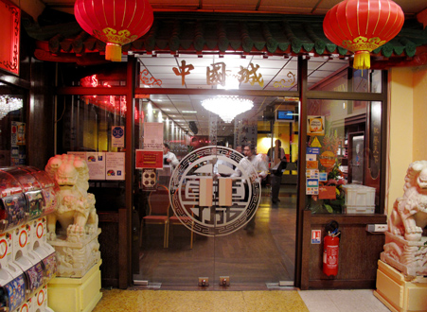
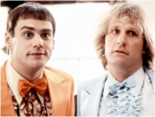
Best use of resources: Human Assisted Graph Search
Given a DAG and some unknown target(s)
We can ask YES/NO questions
E.g. reachability
Asian
Is it Asian?
: YES
East Asian
Is it Thai?
: No
Japanese
Chinese
Thai
Sushi
Ramen
Is it Chinese?
: YES
HumanAssisted Graph Search: It’s Okay to Ask Questions,
A. Parameswaran, A. D. Sarma, H. G. Molina, N. Polyzotis, j. Widom, VLDB ‘11

Slide 71
The Objective
Find an optimal set of questions to find the target nodes
Optimize cost: Minimal # of questions
Optimize accuracy: Minimal # of possible targets
Challenges
Answer correlations (Falafel → Middle Eastern)
Location in the graph affects information gain (leaves are likely to get a NO)
Asking several questions in parallel to reduce latency

Slide 72
Problem Dimensions
Single target/Multiple targets
Online/Offline
Online: one question at a time
Offline: pre-compute all questions
Hybrid approach
Graph structure

Slide 73
Importance of (good) ui
Good UI – better results
Good UI – faster results
Bad UI – inaccurate results
Bad UI – workers leave without completing the task

Slide 74
Challenges
Open vs. closed world assumption
Asking the right questions
Estimating the quality of answers
Incremental processing of updates

Slide 75
More Challenges
Distributed management of huge data
Processing of textual answers
Semantics
More ideas?

Slide 76
Research agenda
Data Model/Query Language
Query Execution/Query Optimization
Quality Control
Storage/Caching
User Interfaces
Worker Behavior/Worker Relationship Management
Interactivity
Platform design
Hybrid Human/Machine algorithms
(from VLDB’11 Tutorial by Doan, Franklin, Kossman, Kraska)

Slide 77
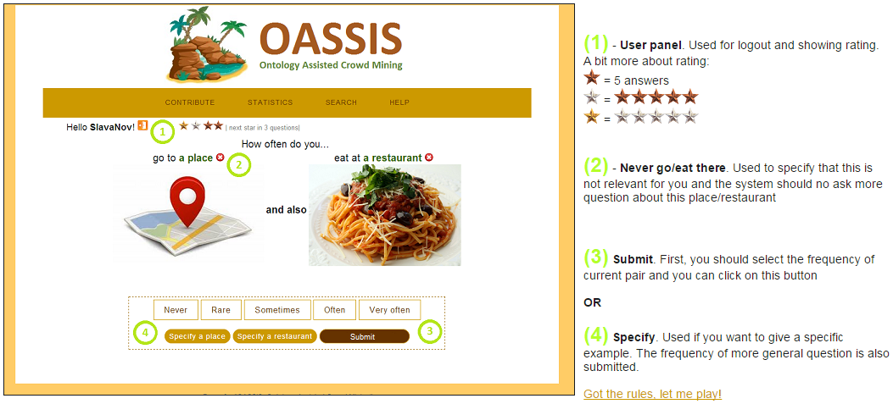
TEASERS

Slide 78
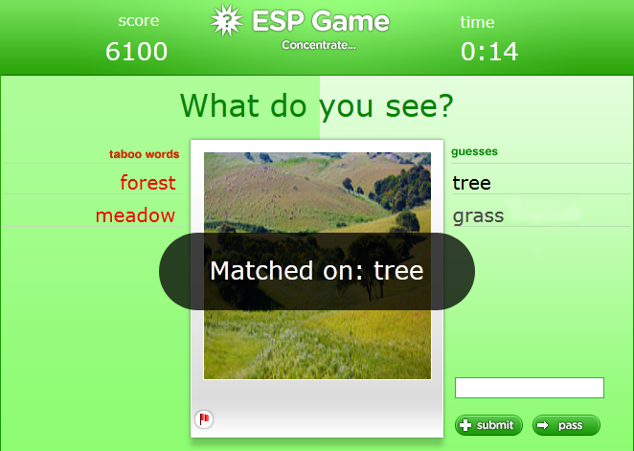
TEASERS

Slide 79
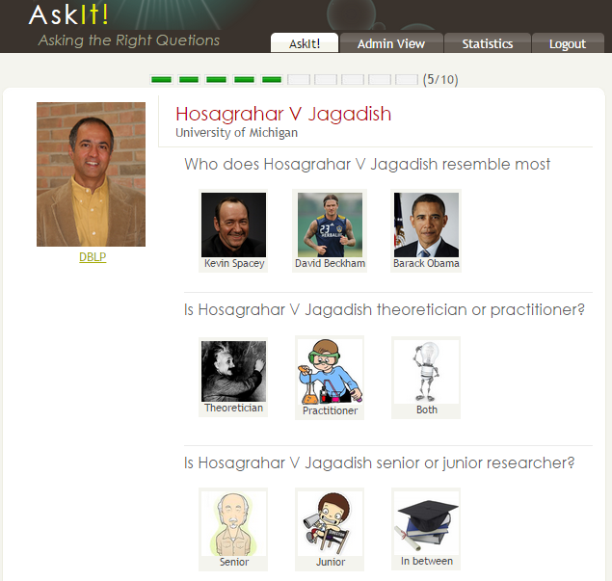
TEASERS

Slide 80
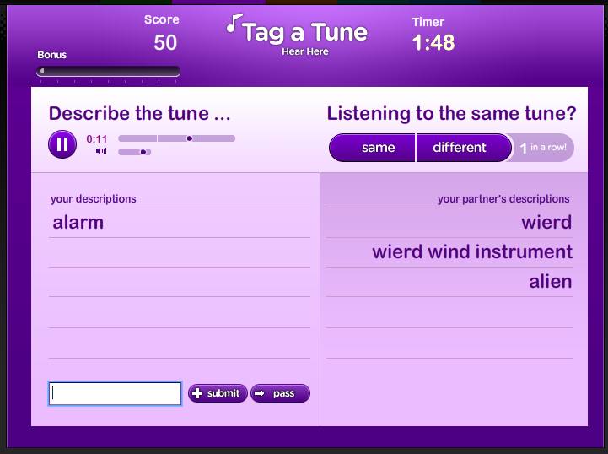
TEASERS

Slide 81
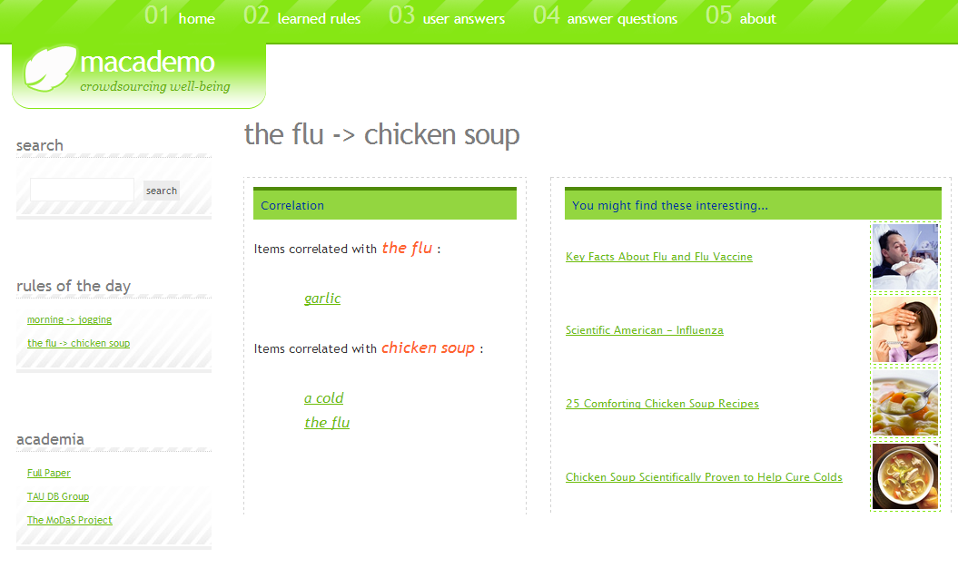
TEASERS

Slide 82
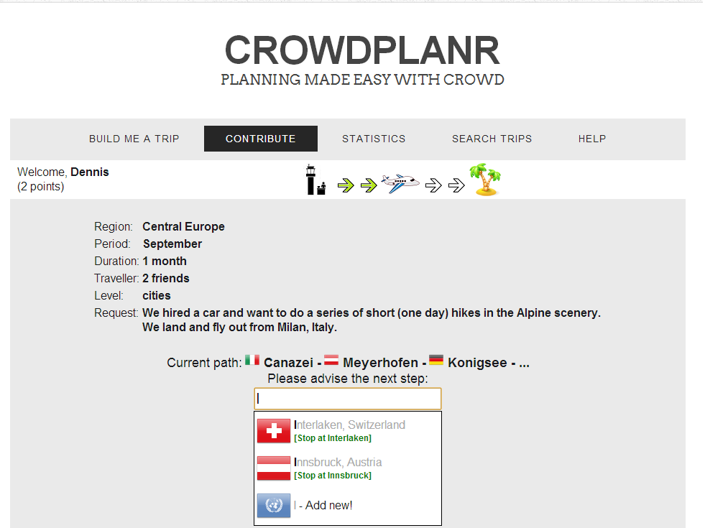

Slide 83
More – next week…
Questions?

Slide 84
References
This presentation partially based on:
“Counting with Crowd” slides by Adam Marcus
Crowdsourcing tutorial from VLDB’11 by Doan, Franklin, Kossman and Kraska
“Introduction to Crowdsourcing” slides by Tova Milo
References:
https://users.soe.ucsc.edu/~alkis/papers/ivd.pdf
https://amplab.cs.berkeley.edu/wp-content/uploads/2011/06/CrowdDB-Answering-Queries-with-Crowdsourcing.pdf
http://db.csail.mit.edu/pubs/mturk-cameraready.pdf

